Slide 1
PHOTOSCAPE LIBRARY

Slide 2
INDEX
Introduction
Project profile
-Scope of the system
-Modules and users
-Tools & technology
Analysis
-Need for the system
-System flow diagram
-UML diagrams
Data dictionary
Design
-Reports (Samples)
Test plan & Test cases
Future work
Bibliography

Slide 3
INTRODUCTION
In case you're a picture taker, you need a totally different site from an online storekeeper, or a dental specialist, or an eatery… you need one that puts your photos up front, with no interruptions. A site with a "stunning" impact.
There are heaps of approaches to make your own photography site—one that is as unmistakable as your own style. Keeping that thing in mind we tried to make a photography website. Investigate and perceive how these picture takers did it.

Slide 4
PROJECT PROFILE
Photography is quick developing as a famous profession decision among all the age gatherings. Photography is both a science and a craftsmanship. It is an aesthetic methods for articulation, the camera supplanting the pen or the paintbrush.
In our website we used the idea to make a simple photography website in which a normal photography lover can also explore our website, upload photos for editing(i.e. touchup to make it more presentable),download our clicked photos which they wish to use as a wallpaper.

Slide 5
PROJECT PROFILE
Modules
-upload/download
-edit
-booking
-photospace(gallery)
Users
-admin
-site visitor
-membership
-subscriber

Slide 6
PROJECT PROFILE
Tools & Technology
Tool:-
Backend user- Php
Frontend user- HTML/ CSS / JS / Bootstrap
Database- SQL
Technologies:-
Xamp Server

Slide 7
ANALYSIS
You don’t need to know someone, or have an agent, or have a name to contribute to website. We’re the place where creators meet their audience, where individuals become a community and where anyone can become a source for creativity. So whether you’re new to photography or consider yourself a pro—your images are welcome here.
So a system was needed to reduce the task and enhanced editing which will hardly consume an hour.

Slide 8
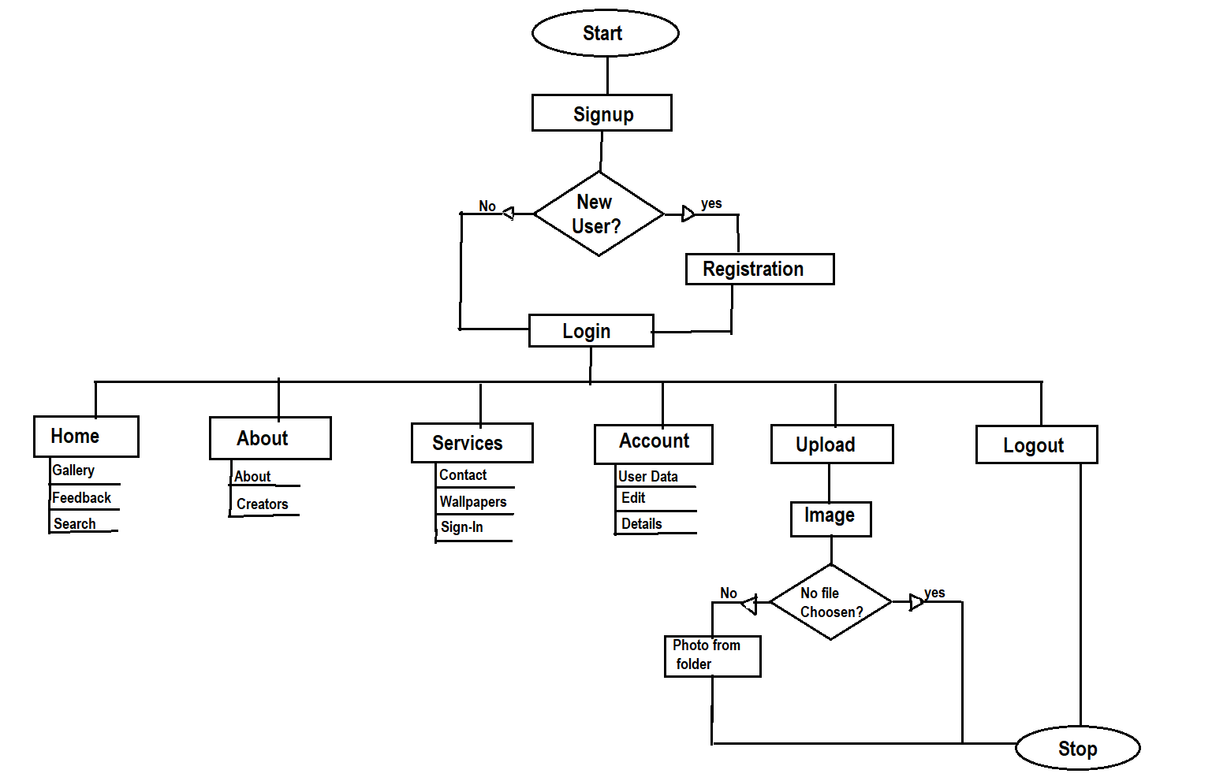
System Flow Chart

Slide 9
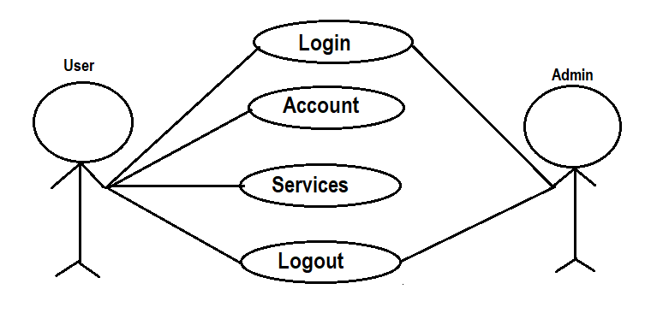
UML DIAGRAMS
Use case diagrams
Use-Case Diagram of system

Slide 10
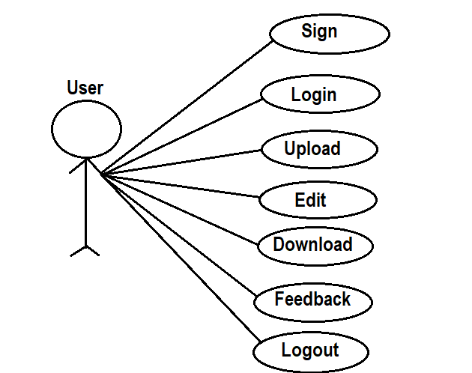
Sub Use-Case Diagram (User)

Slide 11
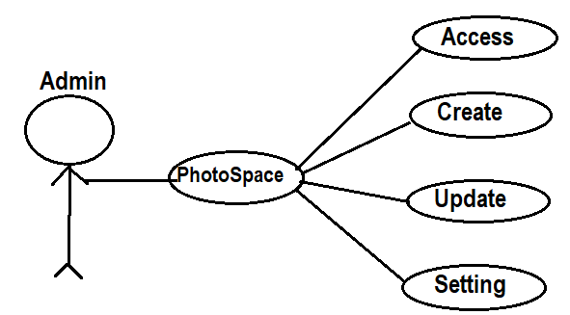
Sub Use-Case Diagram (Admin)

Slide 12
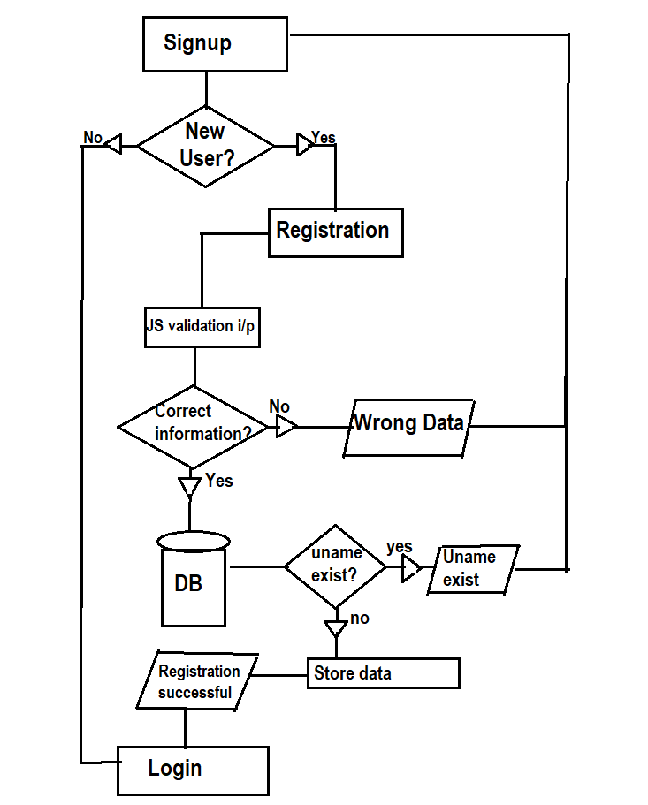
Activity diagram
Signup activity

Slide 13
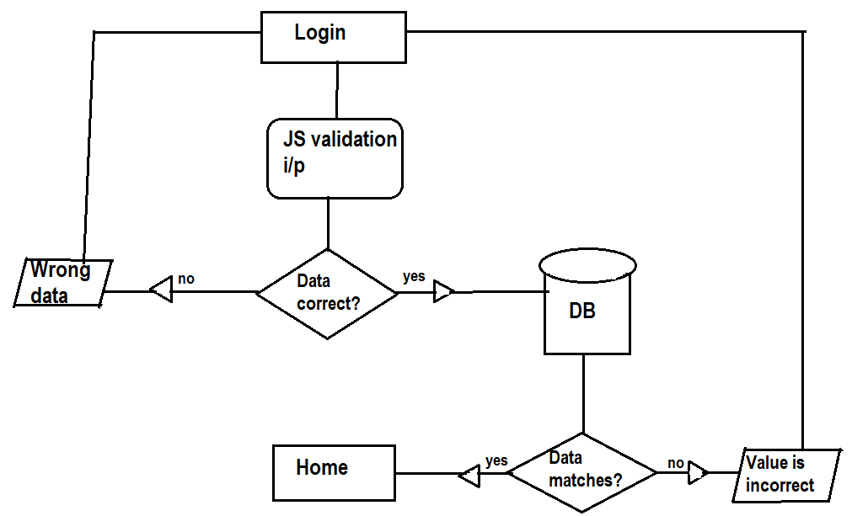
Login activity

Slide 14
DATA DICTIONARY
Feedback Database:
Fname | Ftype | Fsize | Field constraint
Id | Int | 255 | Pk, Not null
User | Text | 255 | Not null
Email | Text | 255 | Not null
Mobile | Text | 255 | Not null
comment | text | 255 | Not null
Image Database:
Fname | Ftype | Fsize | Field Constraint
Id | Int | 255 | PK, Not null
filename | varchar | 255 | Not null

Slide 15
Login database
Fname | Ftype | Fsize | Field Constraint
Username | Text | 255 | PK ,Not null
Email | Text | 255 | Not null
Password | Text | 255 | Not null
cpass | Text | 255 | Not null

Slide 16
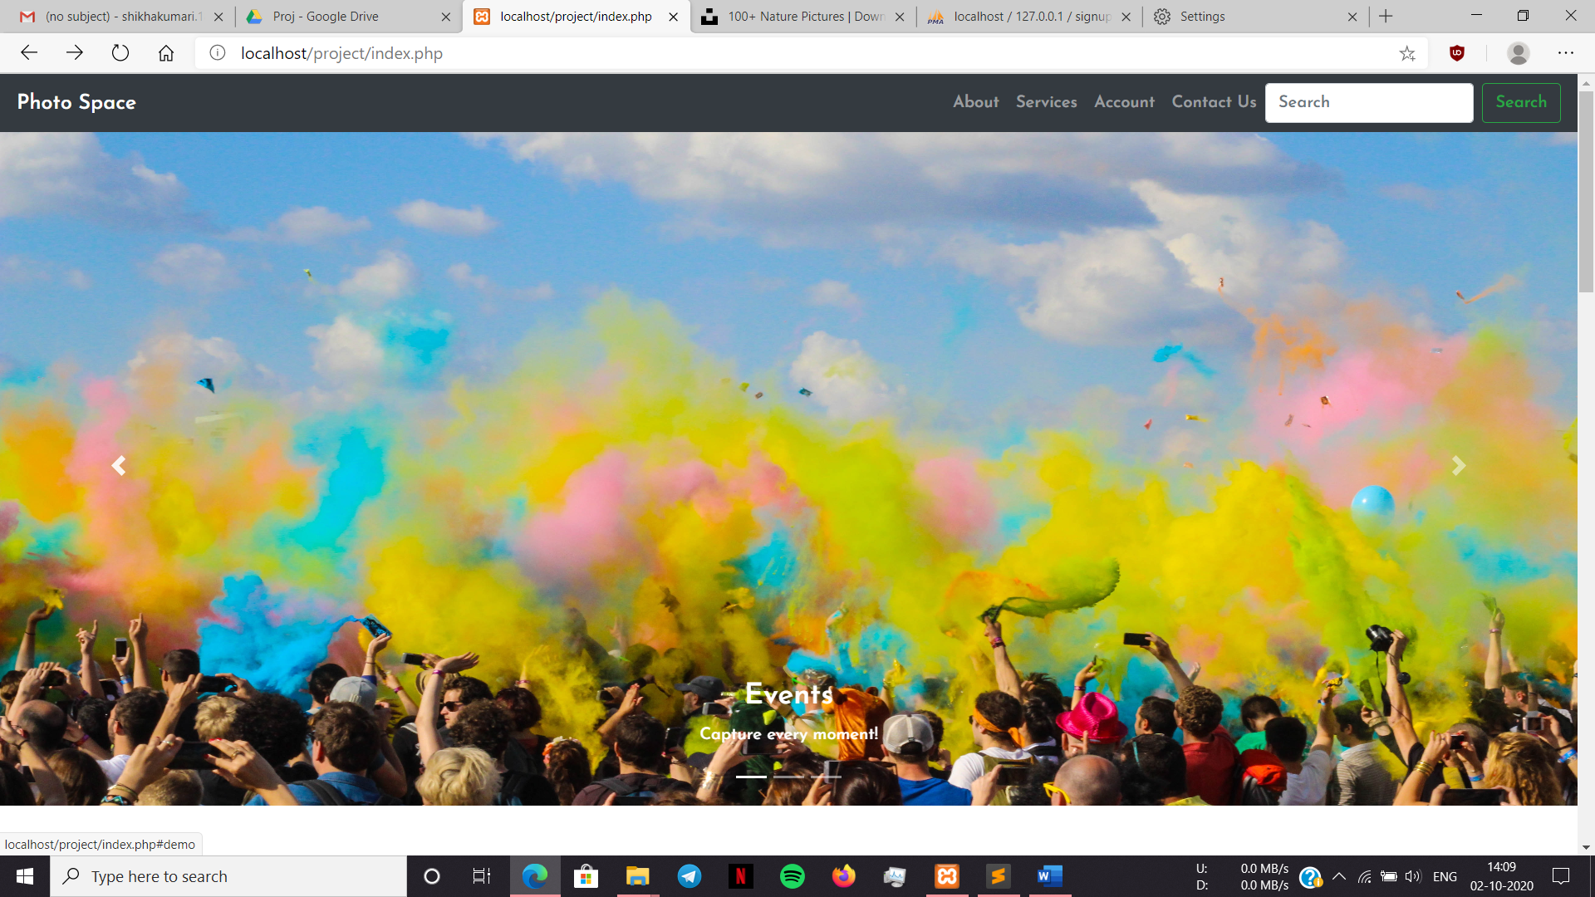
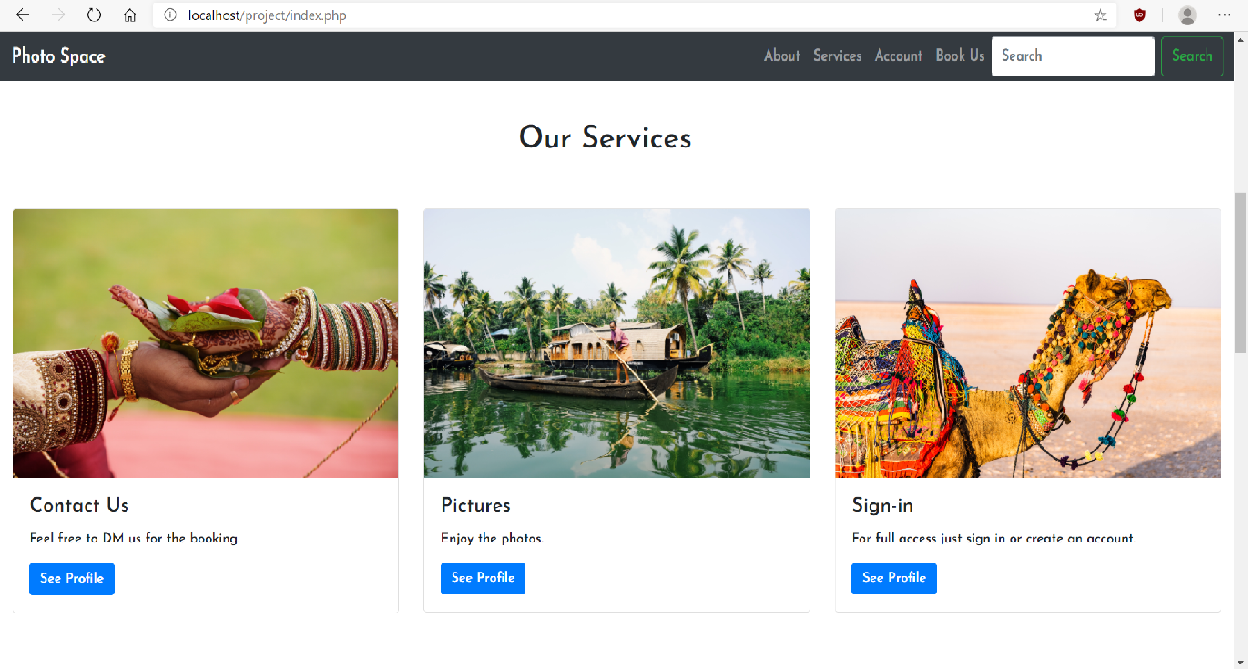
DESIGN

Slide 17
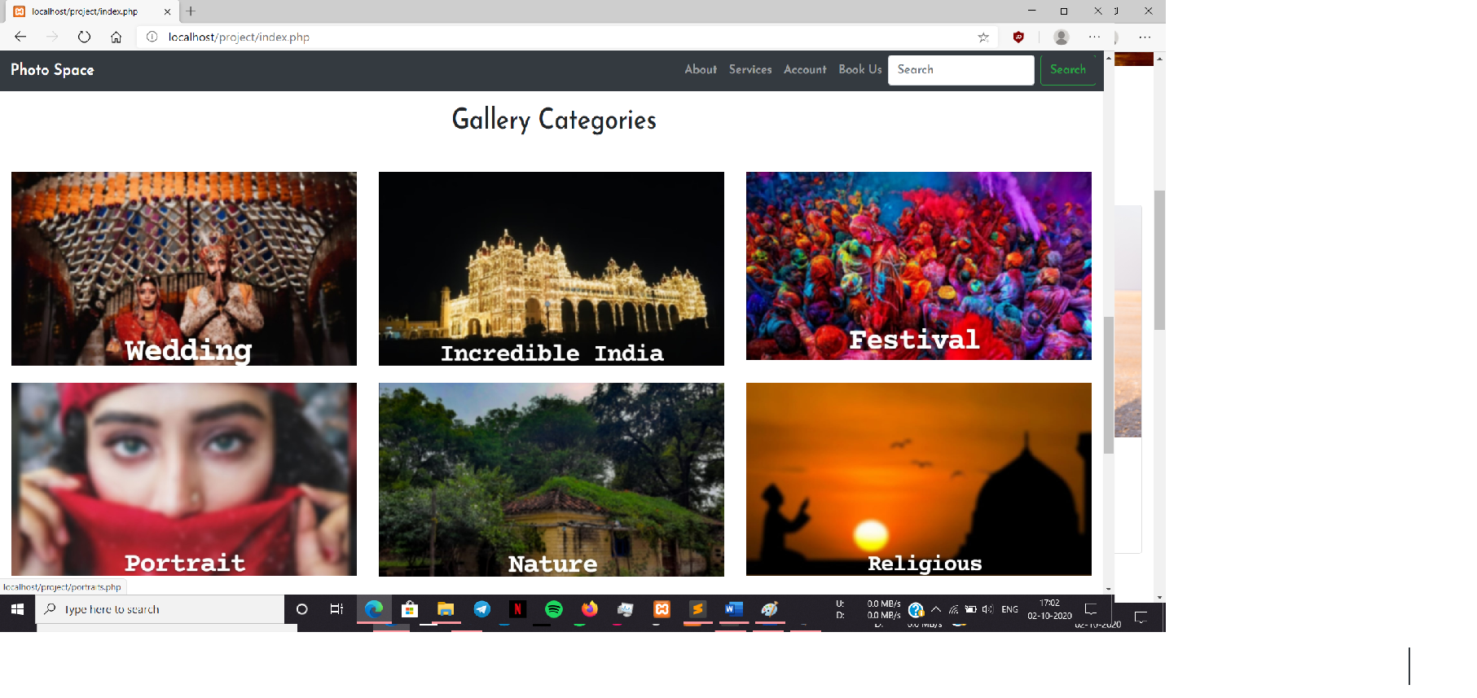
Home Page:

Slide 18
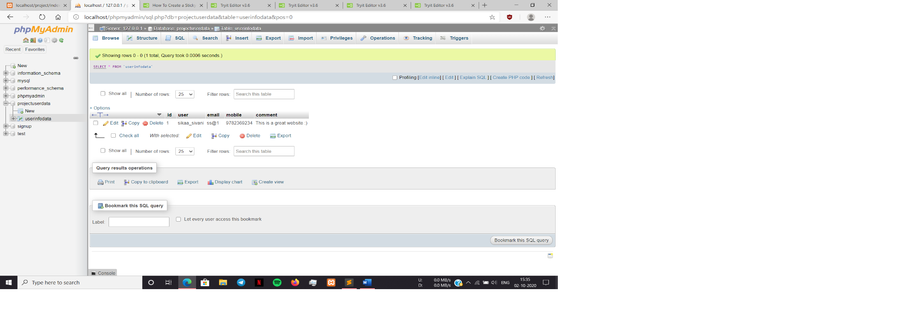
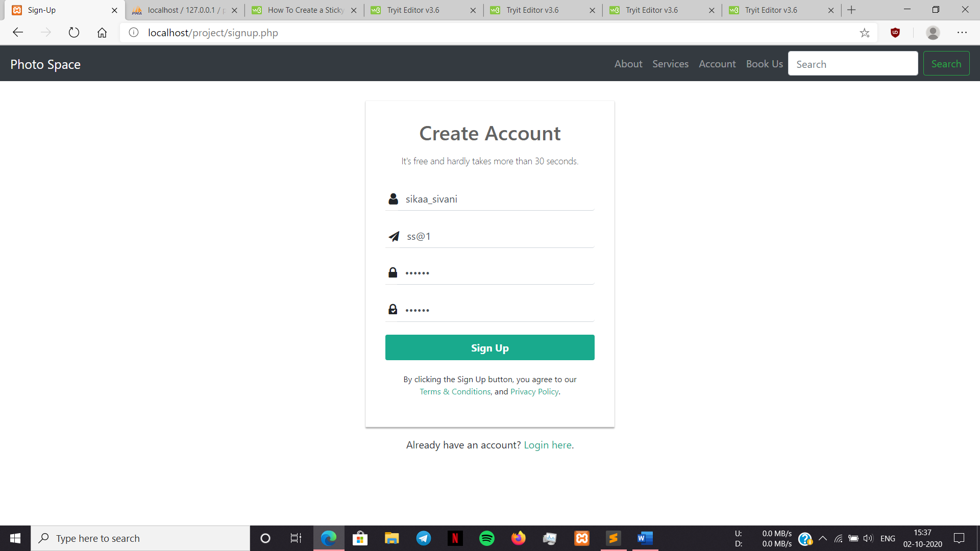
Feedback form db.:

Slide 19
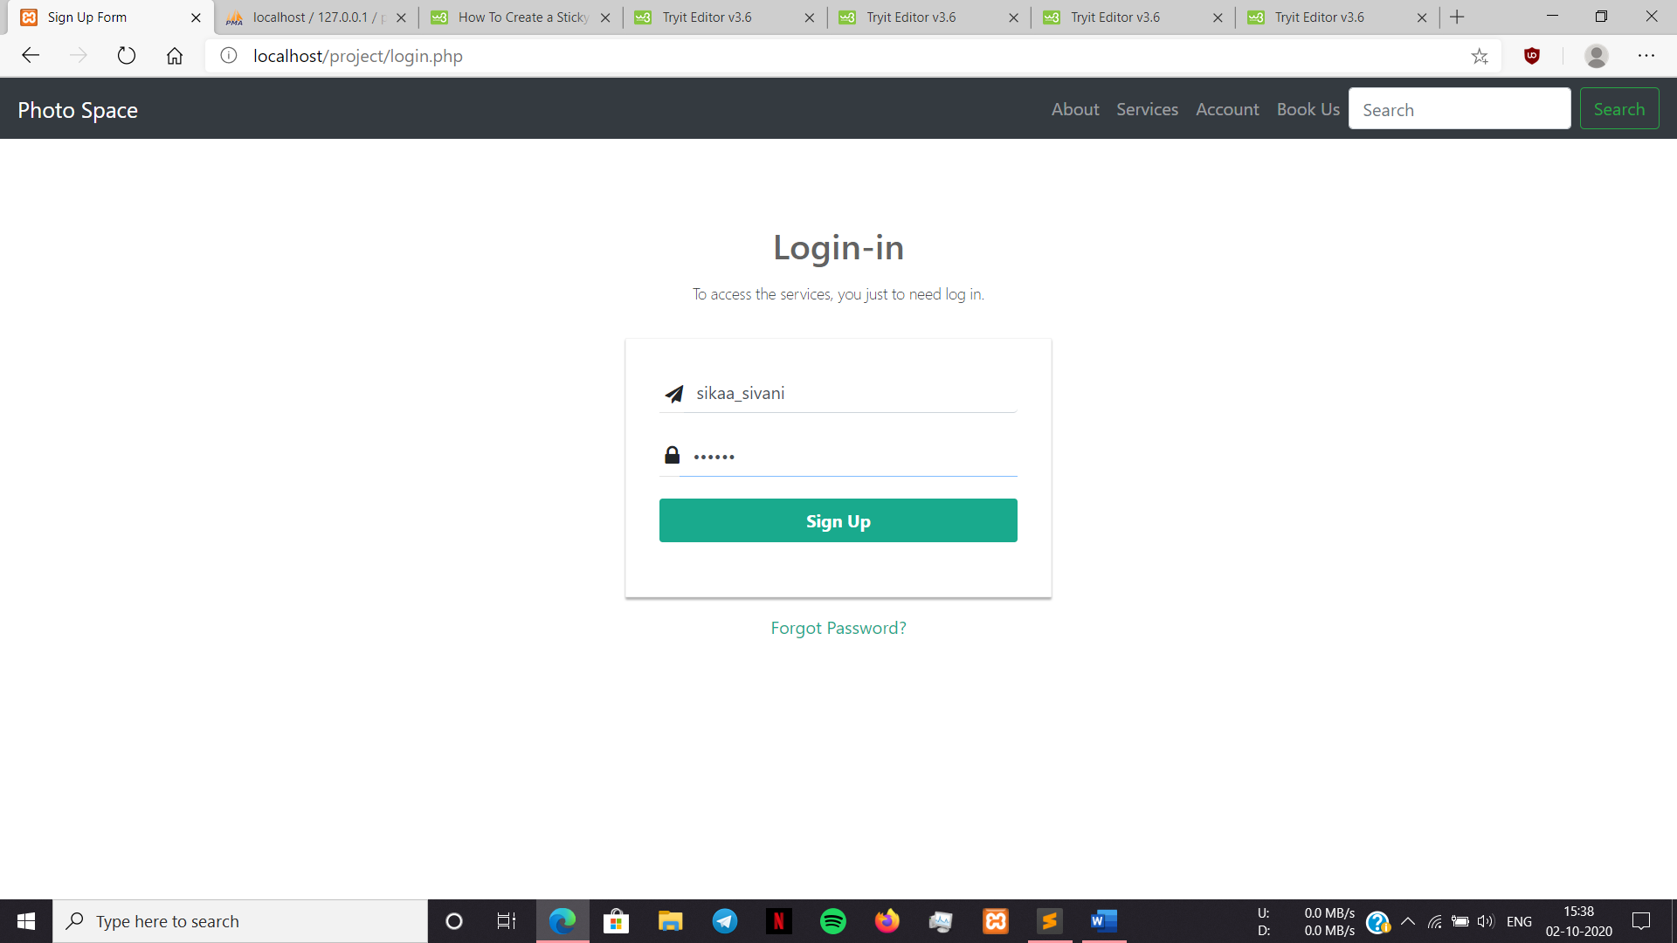
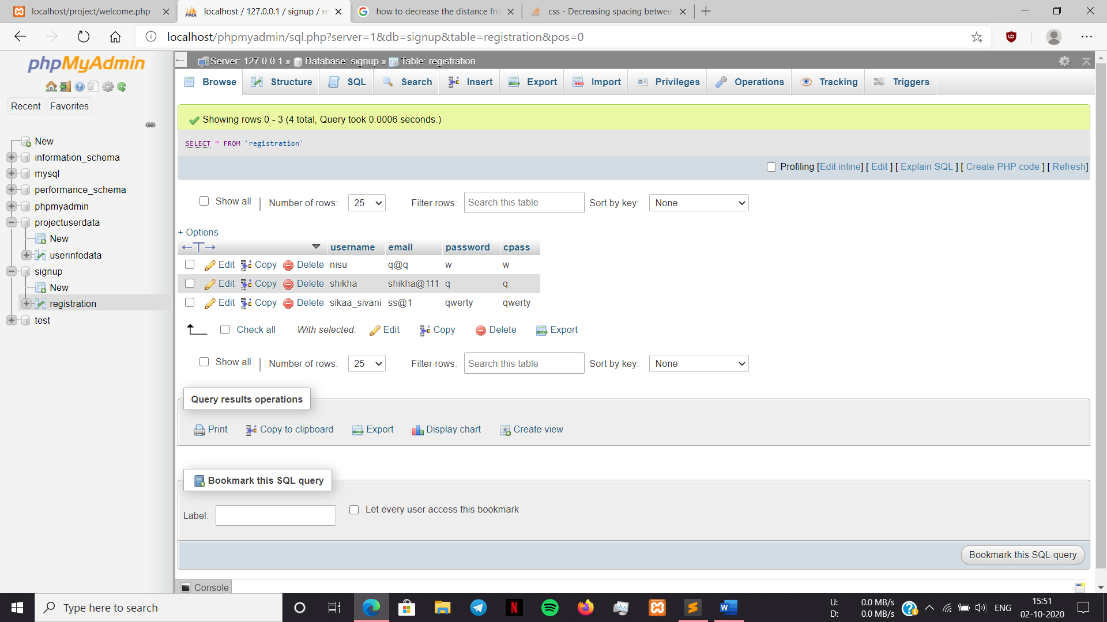
Login db.:

Slide 20
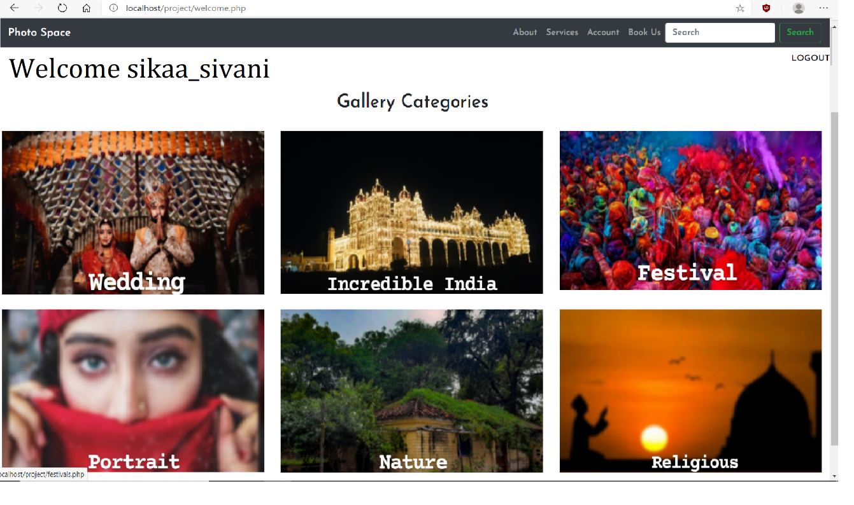
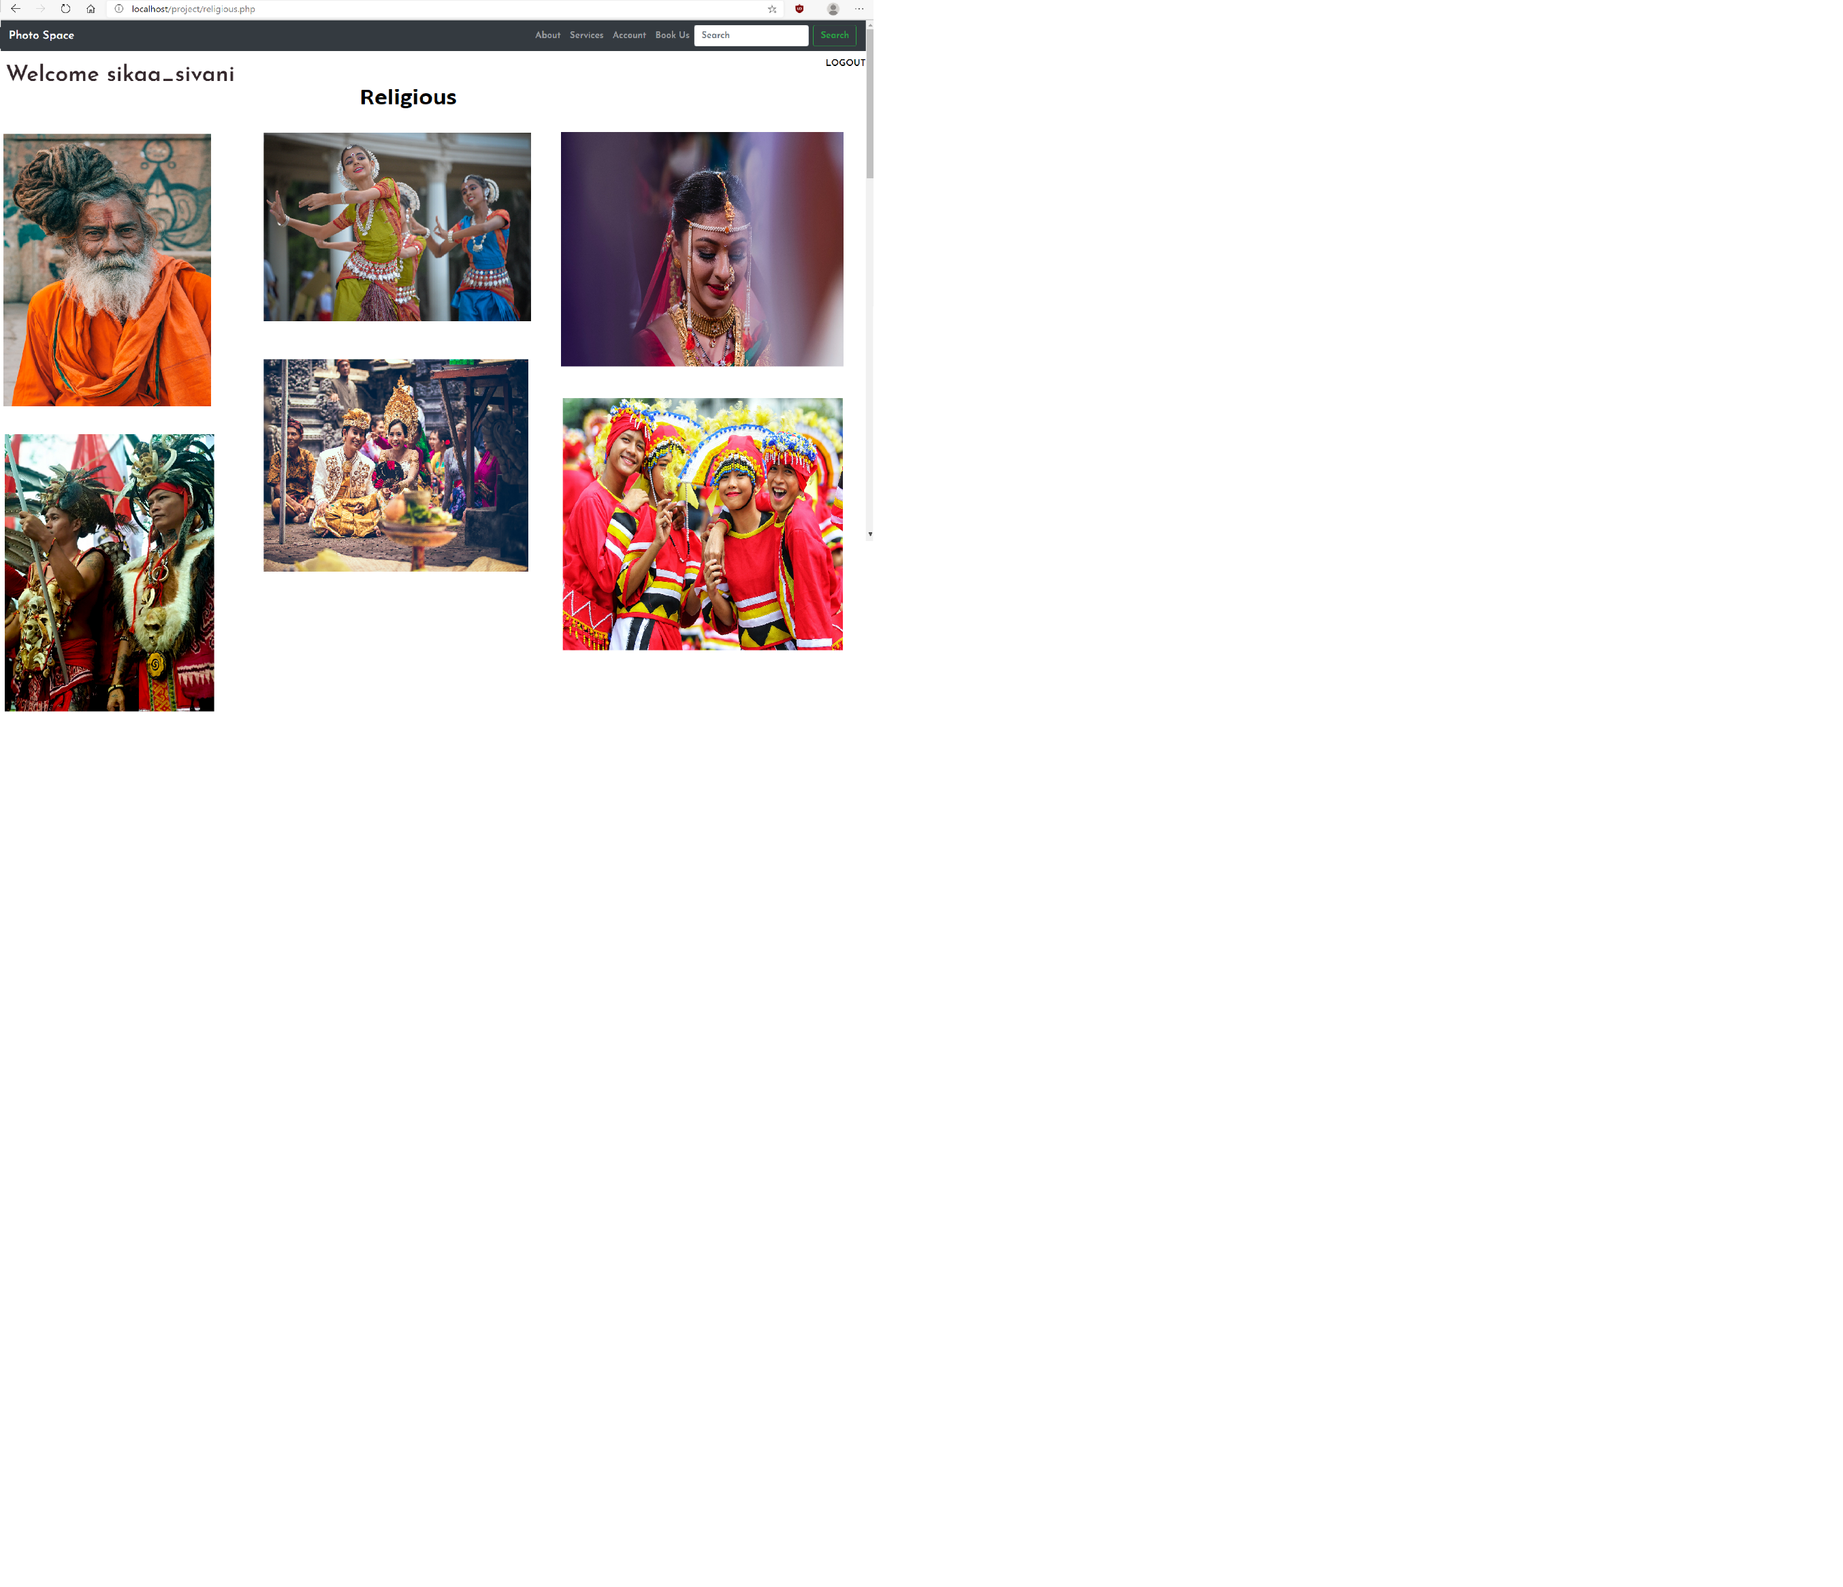
Your account after login: (shows welcome with your username)
Also has log out option
At the bottom has upload images option:
Religious is one of those above categories of pictures(contains awesome pictures):

Slide 21
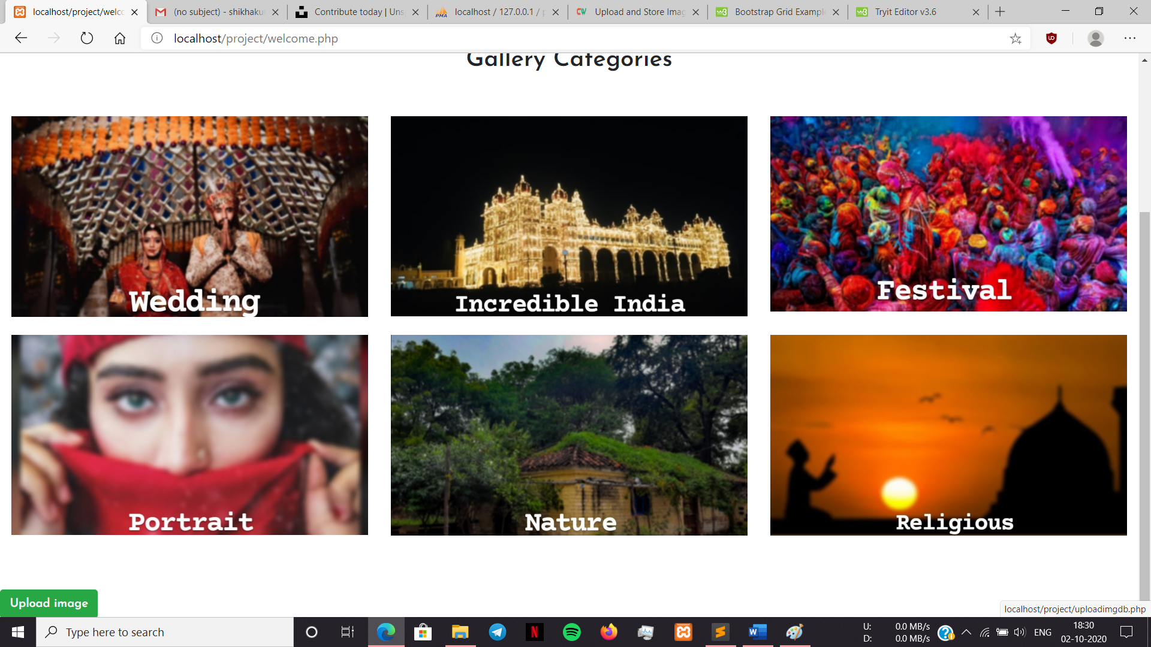
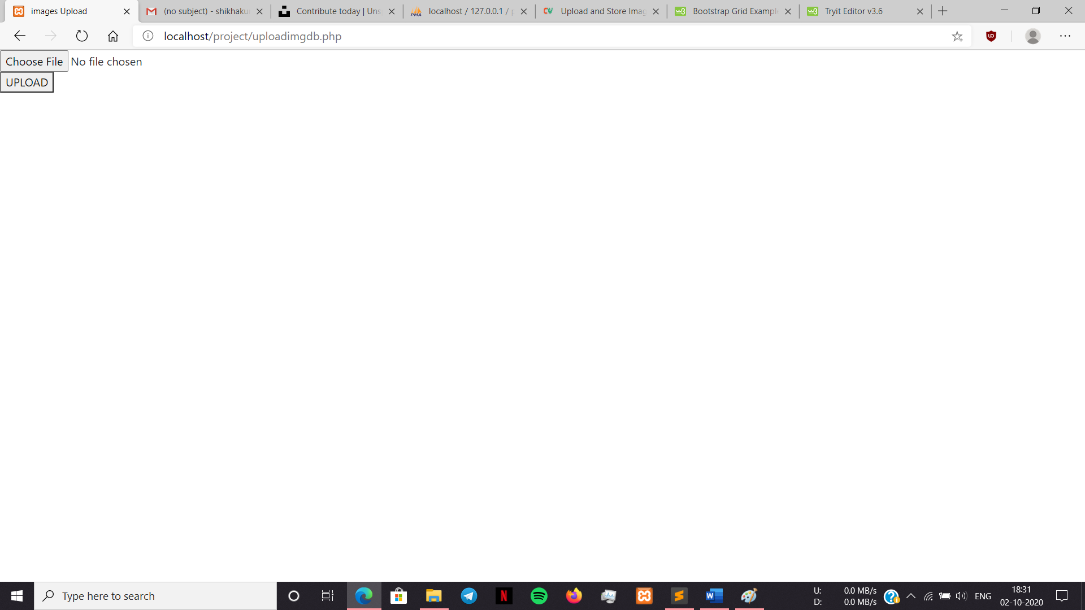
Upload image:
No file chosen yet:

Slide 22

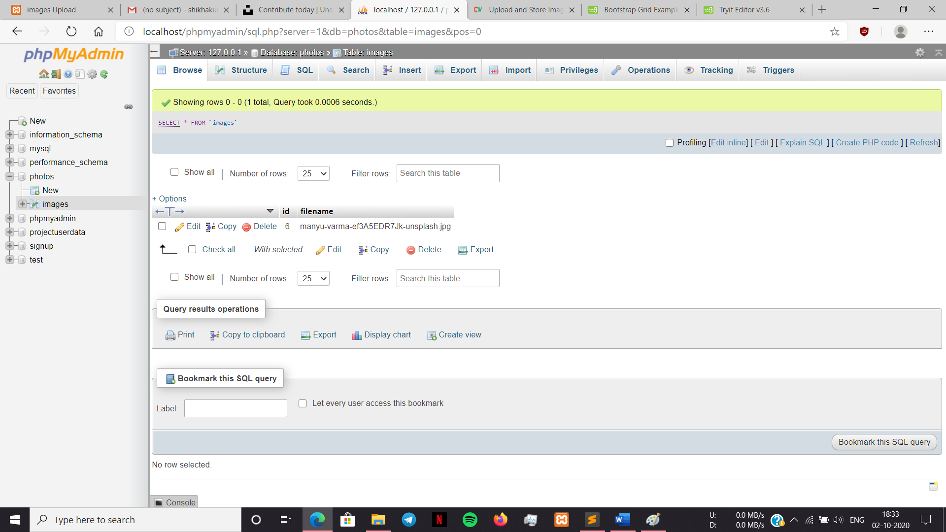
File chosen:
Uploaded! Appears in database:

Slide 23

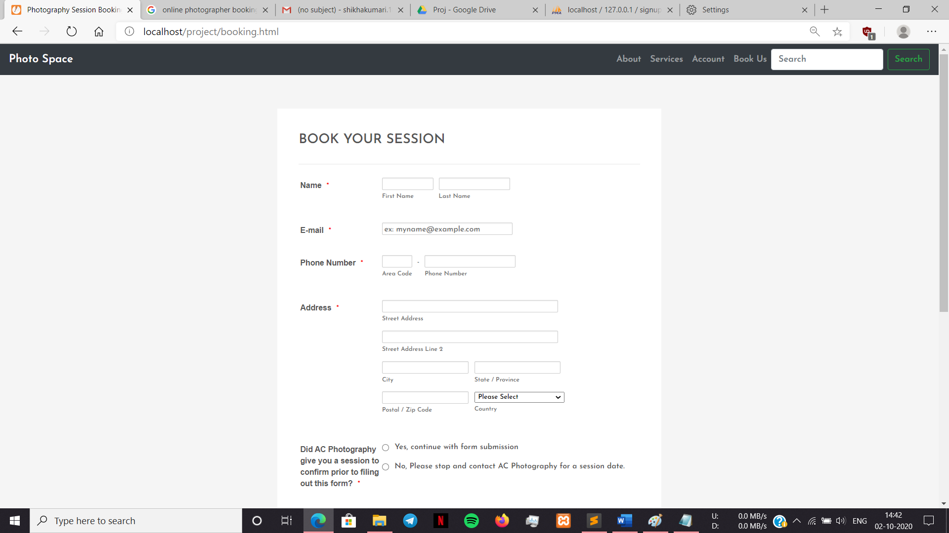
About page:
Contact us page(optional):

Slide 24
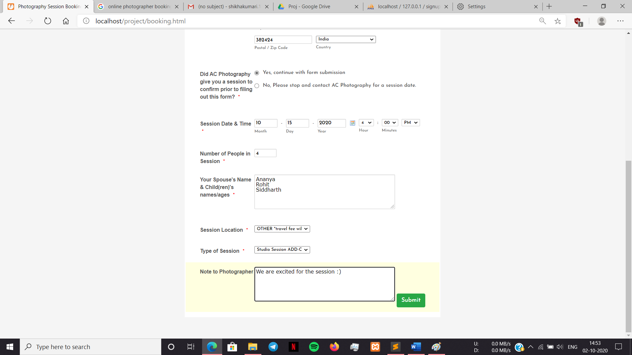

Slide 25
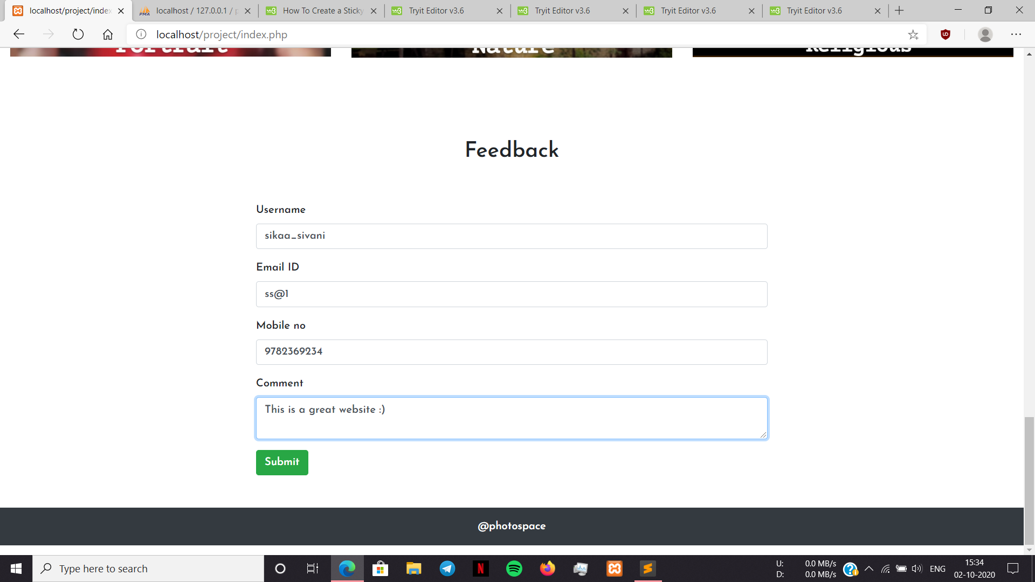
Feedback page:

Slide 26
BIBLIOGRAPHY
https://bootsnipp.com/tags/signup
https://www.w3schools.com/php/DEFAULT.asp
https://getbootstrap.com/
https://in.pinterest.com/

